Slide 1

GitOps the Hard Way
Rebuilding a Source of Truth for an EVPN Fabric (Three Times)
Radim Roška · ALTEPRO solutions

Slide 2

CRA DC Migration
BEFORE:
Legacy DC services
Unicast + multicast variants
No service catalog
Knowledge in people and configs
AFTER:
EVPN/VXLAN fabric
Explicit service model
Fabric & Service SOT
CI driven changes
· 2 DCs · ~40 ARISTA switches · automated from day one
Notes:
This was a real production DC migration for CRA. Dual-DC Arista EVPN/VXLAN fabric, around 40 switches, automated from day one. The story is not about the fabric. It is about turning what existed only in people and running configs into an explicit service model.

Slide 3
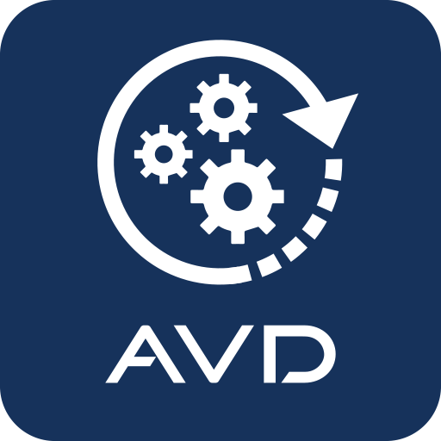
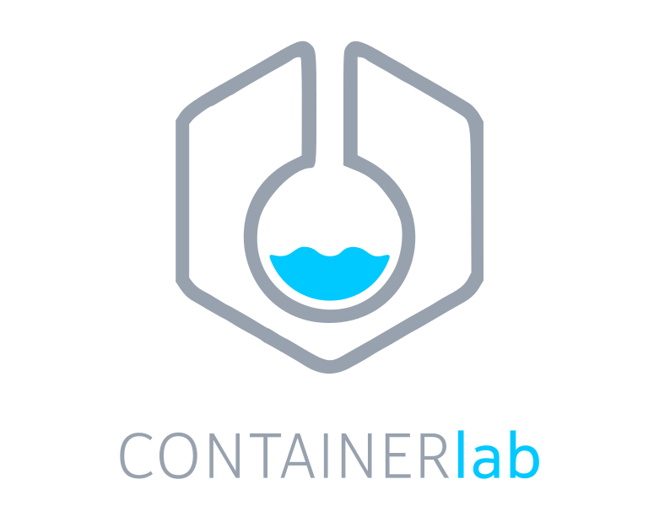
False Confidence
Dual-DC fabric in Containerlab: running after a few days
ARISTA AVD – ready to use YAML data model
“Maybe AVD will do all the work for us?”
+
Notes:
Hardware lead time was close to one year. That gave us a rare luxury — we could build the network before the network existed. AVD and Containerlab gave us a working dual-DC fabric in a few days. That is the moment where the title started to matter. The fabric was the easy part. The services were not.

Slide 4
Before Migration: Define the Service Model There was no catalog to import. We built one with CRA.
1. Define service catalog
types / variables / model schema
2. Fill migration workbench
existing services -> structured rows in xlsx
3. Design migrator.py
xlsx -> CRA service YAML (service SOT)
Notes:
The first step was not writing Python. It was agreeing with CRA what a service actually is — what counts as one service, what its variables are, where its boundaries run. There was no catalog to import. The knowledge lived in people, running configs, and CLI practice. Only after we built the catalog with the CRA team did the spreadsheet and migrator make sense. The spreadsheet was not the source of truth. It was a migration workbench.

Slide 5
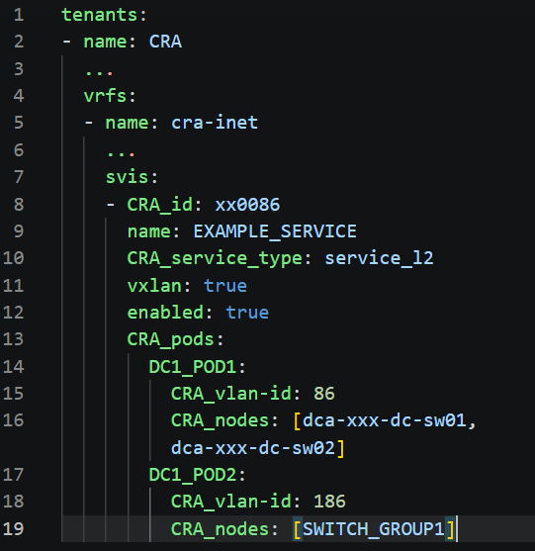
The Model Fought Back
service identity = global
VLAN/VNI mapping = POD-local
-> CRA SOT abstraction
-> translator.py
-> AVD data model
Notes:
AVD handled the generic fabric well. But the real services had a brownfield twist: one service has a global identity, while its VLAN-to-VNI mapping is POD-local. The standard input shape did not carry that cleanly. So we put a CRA service intent above AVD and translated. AVD stayed AVD. We just stopped pretending it was the human interface.

Slide 6

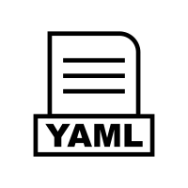

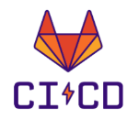
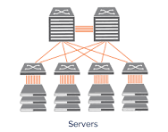

From Service Model to Config: Two Phases
Phase 1: Migration (make migration possible)
migrator.py
LEGACY
services
CRA SOT
Phase 2: Day 2 Operations (make operations safe)
Operator
edits
CRA SOT
service intent
AVD data model
config data
change
control
fabric
CI pipeline: validate · translate · build · deploy
Day 2 tools: avd-editor · avd-validator · avd-finder
Notes:
Two phases.
Phase 1 was the bootstrap — fill the workbench from what existed, run migrator.py,
get the first CRA SOT. One-time.
Phase 2 is how it operates today — humans edit CRA SOT, push to git, open MR.
CI does the rest: validates the intent, runs translator.py, builds configs, deploys.
Around the SOT sit Day 2 tools: editor, validator, finder.
The boundary that matters: operators work with CRA service intent.
Not with generated AVD data. Validation became the interface.

Slide 7
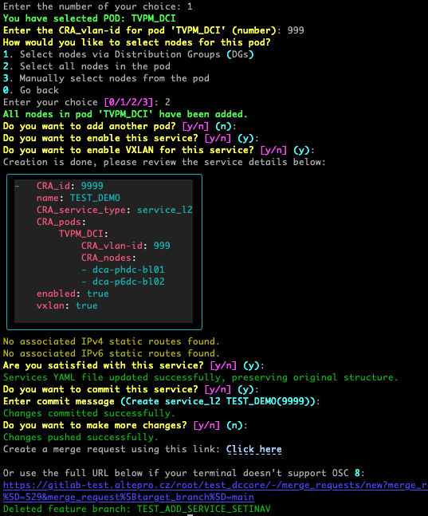
One Year Later
The editor helped. The validator mattered.
Operators run it daily
guided editor or YAML
Git/MR workflow
avd-finder became essential
Cleaner data + mindset change
edit -> commit -> MR -> validate -> translate -> build -> deploy
Notes:
We thought the editor would be the main interface.
In practice, operators trusted the workflow around the SOT —
finder, merge requests, and especially validation.
The editor helped. The validator mattered.
Validation became the interface.
After more than a year in production, operators run Day 2 operations daily.
L1/L2 engineers — not just senior automation people.
They often prefer YAML directly because validation gives them confidence
the change is sound before they push.
avd-finder became essential — operators need to know where a service lives
across the fabric. Without it, they couldn't safely change anything.
The biggest reported benefit was not speed.
It was cleaner data and a different way of thinking about configuration.
In one year, only one bad change made it past validation —
an extra whitespace in a description field.
That tells you what the validator was actually catching.
We designed an interface. Operators adopted a workflow.

Slide 8
What We Learned Not three rewrites -> Three levels of understanding.
Fabric is easy -> legacy services are hard to model
Service intent needs its own abstraction
SOT -> validation -> workflow
We didn't just hand over a fabric.
We built a way to run it safely — every day
Notes:
We designed an interface. Operators adopted a workflow.
Three levels of understanding. Not three rewrites.
First lesson — the fabric was the easy part.
AVD and Containerlab gave us a working dual-DC fabric in days.
Virtual-first works. But legacy services are where the real modeling work lives.
No framework discovers them for you.
Second lesson — service intent needs its own abstraction.
The vendor data model fit the generic case. It did not fit our brownfield reality.
The CRA SOT was the layer where operators could describe service intent —
and translator.py was the bridge to the framework data model.
Third lesson — a production SOT is more than data.
It is SOT plus validation plus workflow.
Operators trusted the validator more than the editor.
The change in thinking was the biggest reported benefit.
Looking back, the three rebuilds were not the failure.
They were the learning process.
We thought we were building a Source of Truth for a fabric.
After three rebuilds, we realized we were building
an operating model for production services.
AVD made the generic fabric simple.
The hard work was discovering, translating, and operating
the production service model.
Thank you.

Slide 9
Questions?

Slide 10
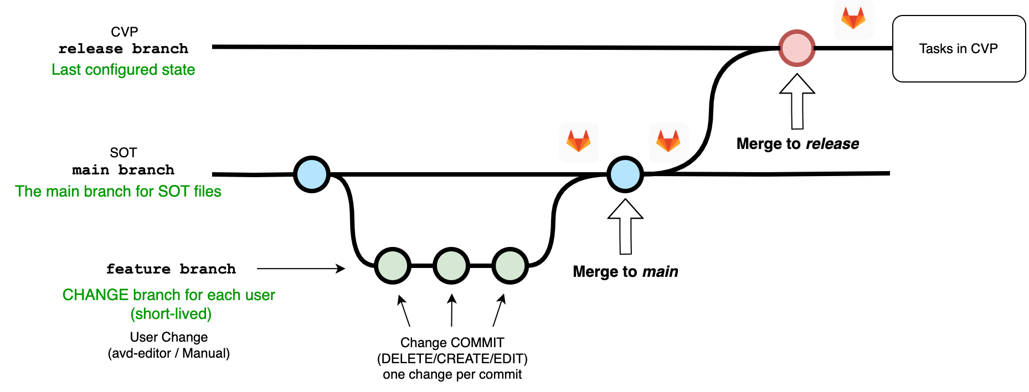
CI Workflow (backup slide)
Notes:
We thought the editor would be the main interface.
In practice, operators trusted the workflow around the SOT —
finder, merge requests, and especially validation.
The editor helped. The validator mattered.
Validation became the interface.
After more than a year in production, operators run Day 2 operations daily.
L1/L2 engineers — not just senior automation people.
They often prefer YAML directly because validation gives them confidence
the change is sound before they push.
avd-finder became essential — operators need to know where a service lives
across the fabric. Without it, they couldn't safely change anything.
The biggest reported benefit was not speed.
It was cleaner data and a different way of thinking about configuration.
In one year, only one bad change made it past validation —
an extra whitespace in a description field.
That tells you what the validator was actually catching.
We designed an interface. Operators adopted a workflow.

